Slide 1
Node Fundamentals
Ali Sleem
Software Engineer
https://www.linkedin.com/in/ali-sleem

Slide 2
Remember
Before You can be Great, You’ve got to be good
Before You can be good, You’ve got to be bad
But, before you can even be bad,
You’ve got to try
Art Williams.

Slide 3
Agenda
Fundamental Concepts
NodeJs
Javascript refreshers
Clean Code
Build a simple CLI tool
History of the web

Slide 4
Node.js is an open-source Asynchronous, event-driven JavaScript runtime environment. built on top of V8 Engine, designed to build scalable network applicaitons
Notes:
https://www.youtube.com/watch?v=cO6asQjQmPM

Slide 5
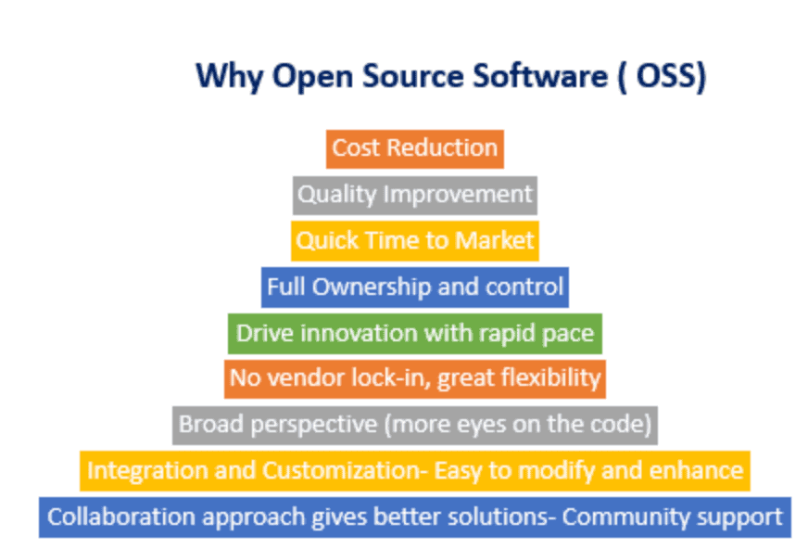

Slide 6
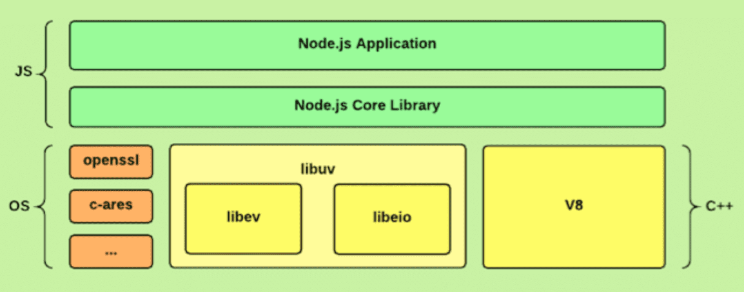

Slide 7
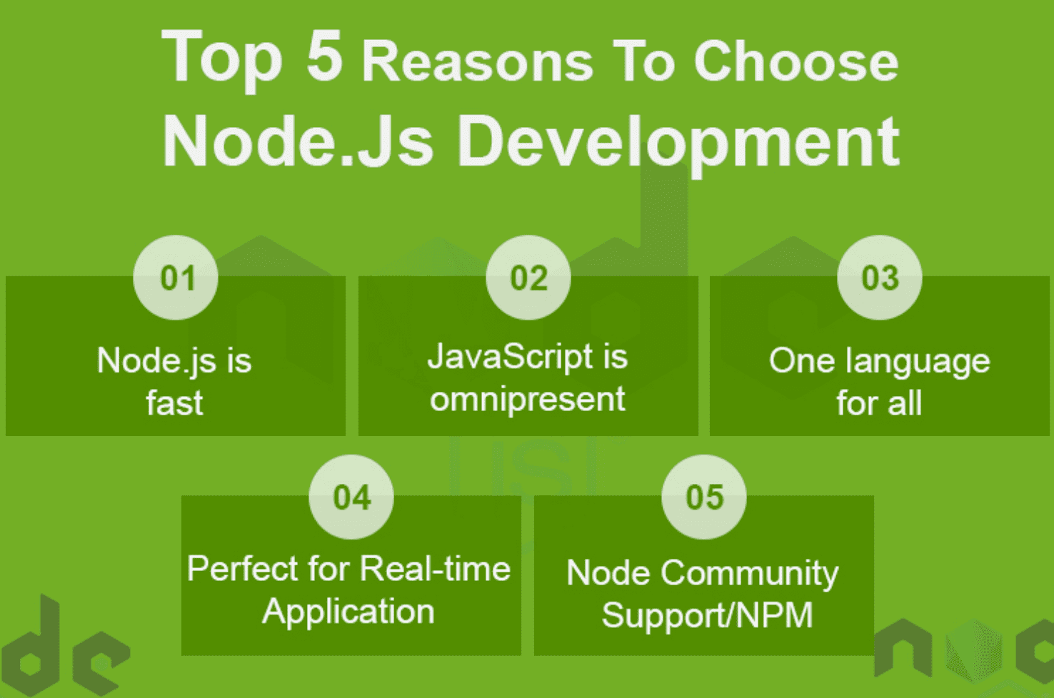

Slide 8
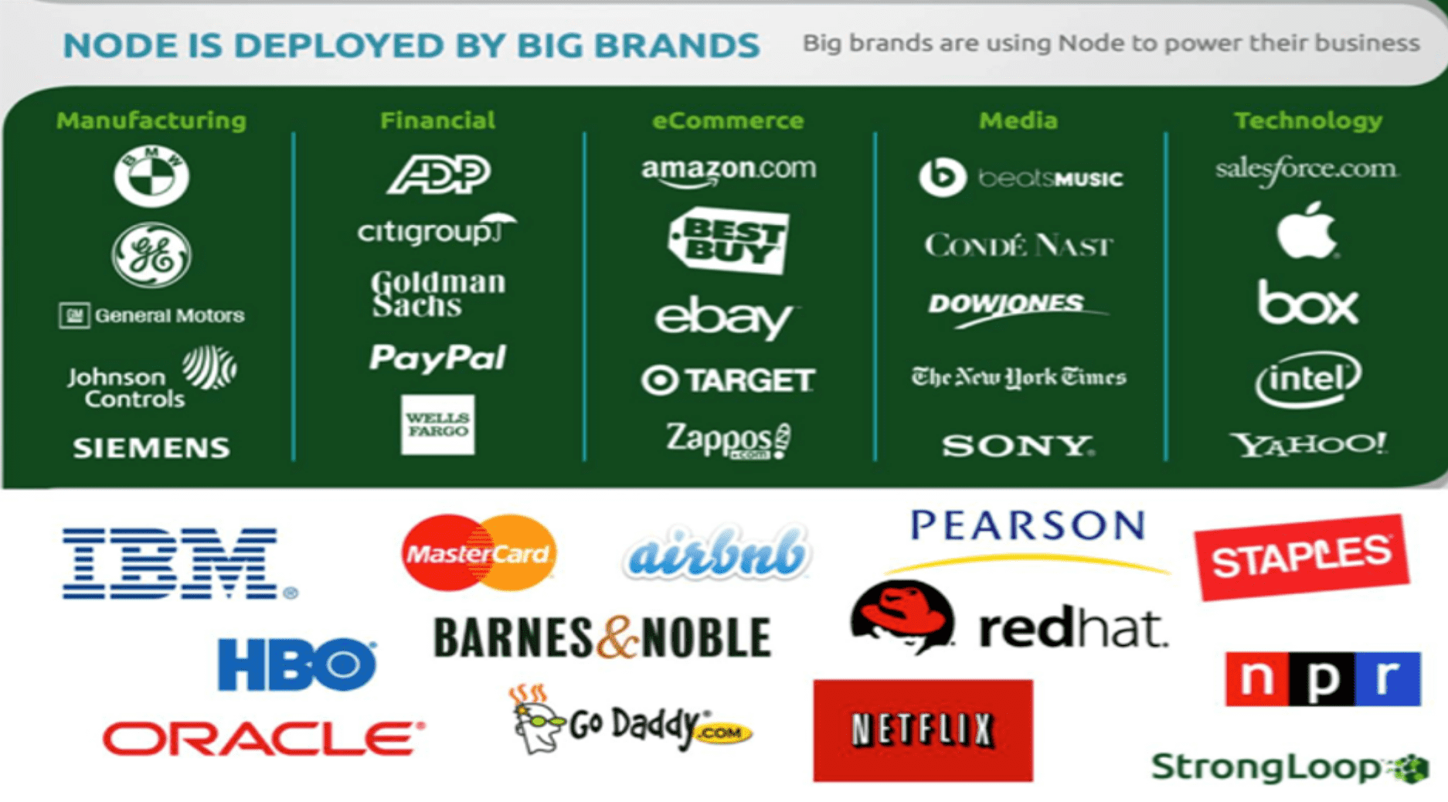

Slide 9
Let’s get into code

Slide 10
History of the web apps
Networking evolutions
Creation of WWW, Tim Berners-Lee Of CERN
DNS
Web server
Client
Protocol
HTML
HTTP
Web browser
URIs
web app
Notes:
https://www.youtube.com/watch?v=cO6asQjQmPM

Slide 11
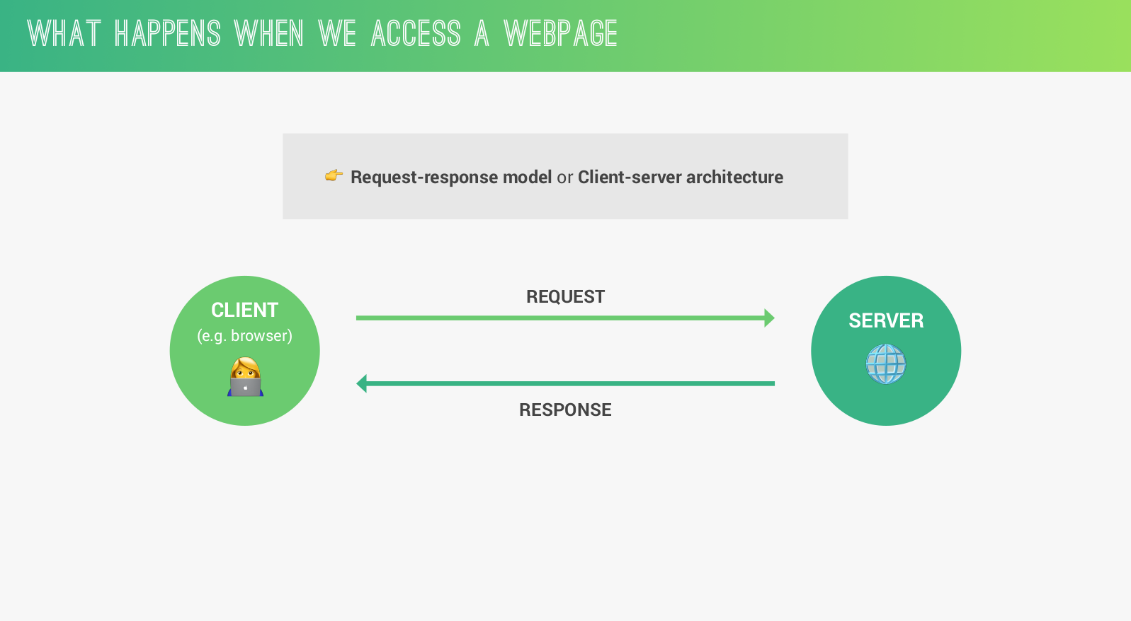

Slide 12
Introduction to WEB
The web has, from its inception, been structured around the idea of resources.
Generally a platform for sharing simple text/HTML based files, documents, images etc. (Resource-oriented)
Most web applications are built around a client-server model.
Client could be something as simple as a web browser, crawlers, programs, scripts.
Server presents only as a single machine virtually
The web has evolved into a more complex network of interconnected applications.
Between the Web browser and the server, numerous computers and machines relay theses messages.
Moving from desktop apps to web

Slide 13
But How these messages are transferred ….?
clients and servers had to agree upon a set of conventions — a protocol — that dictates all communication between them.
This protocol allows a web server to:
Receive the information — requests — sent by any client.
Process these requests..
Send the appropriate responses.
There are lots of protocols that can transfer data between client and a server.
Ex: HTTP, HTTPS, FTP, SMTP
Each of them has its purposes and functionalities.
Notes:
OSI Model

Slide 14
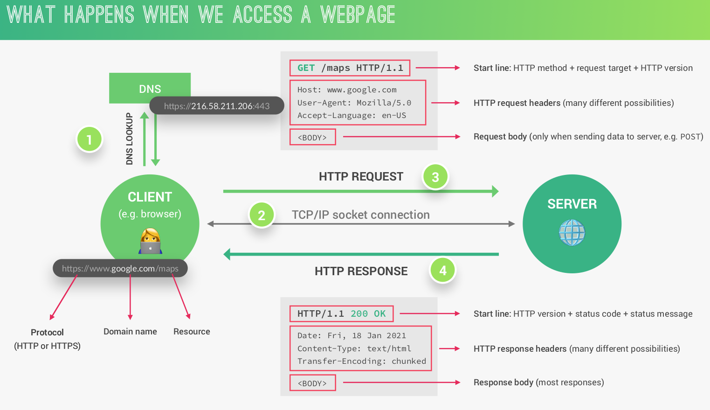

Slide 15
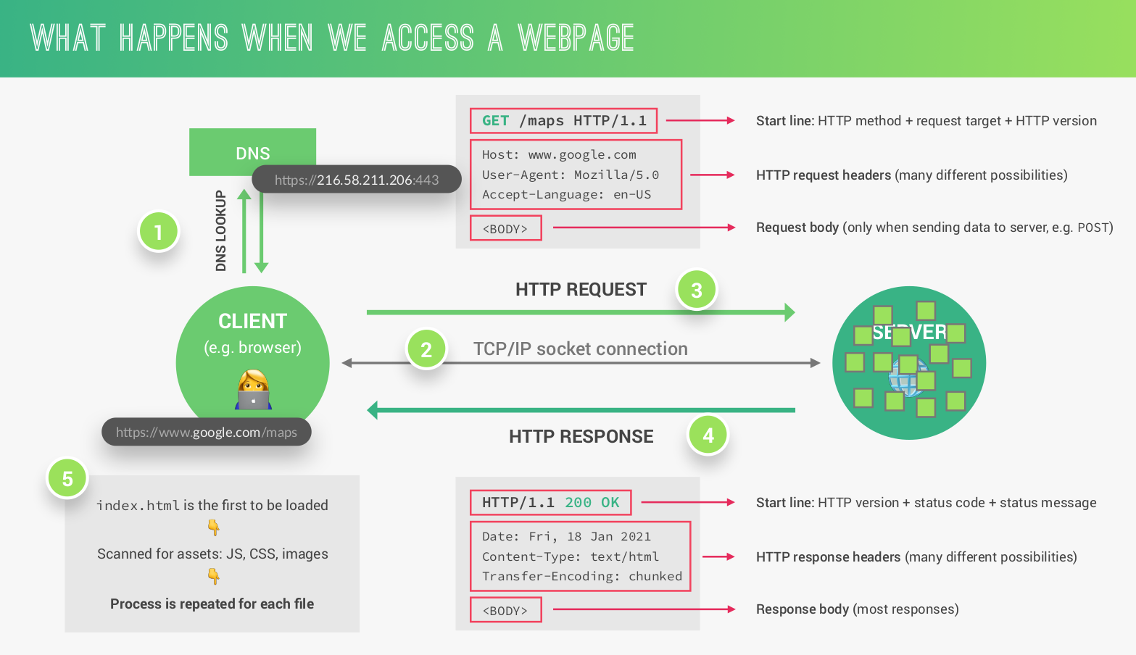

Slide 16
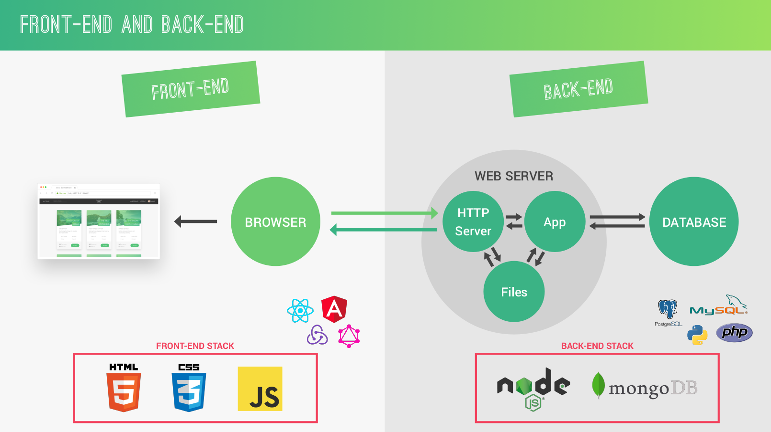

Slide 17
2. Hypertext Transfer Protocol “HTTP”
What is it all about ?

Slide 18
2.1. What is HTTP ?
HTTP stands for Hypertext Transfer Protocol.
It is the standard protocol for transferring web pages (and their content) across the Internet.
HTTP provides a structured format for exchanging data over the web.
HTTP is a stateless protocol. Server doesn’t keep any data between 2 requests.
HTTP has the guidelines needed to describe the following:
Client request.
Server response.
Let’s check the whole request/response cycle…...
Notes:
https://developer.mozilla.org/en-US/docs/Web/HTTP/Overview#components_of_http-based_systems

Slide 19

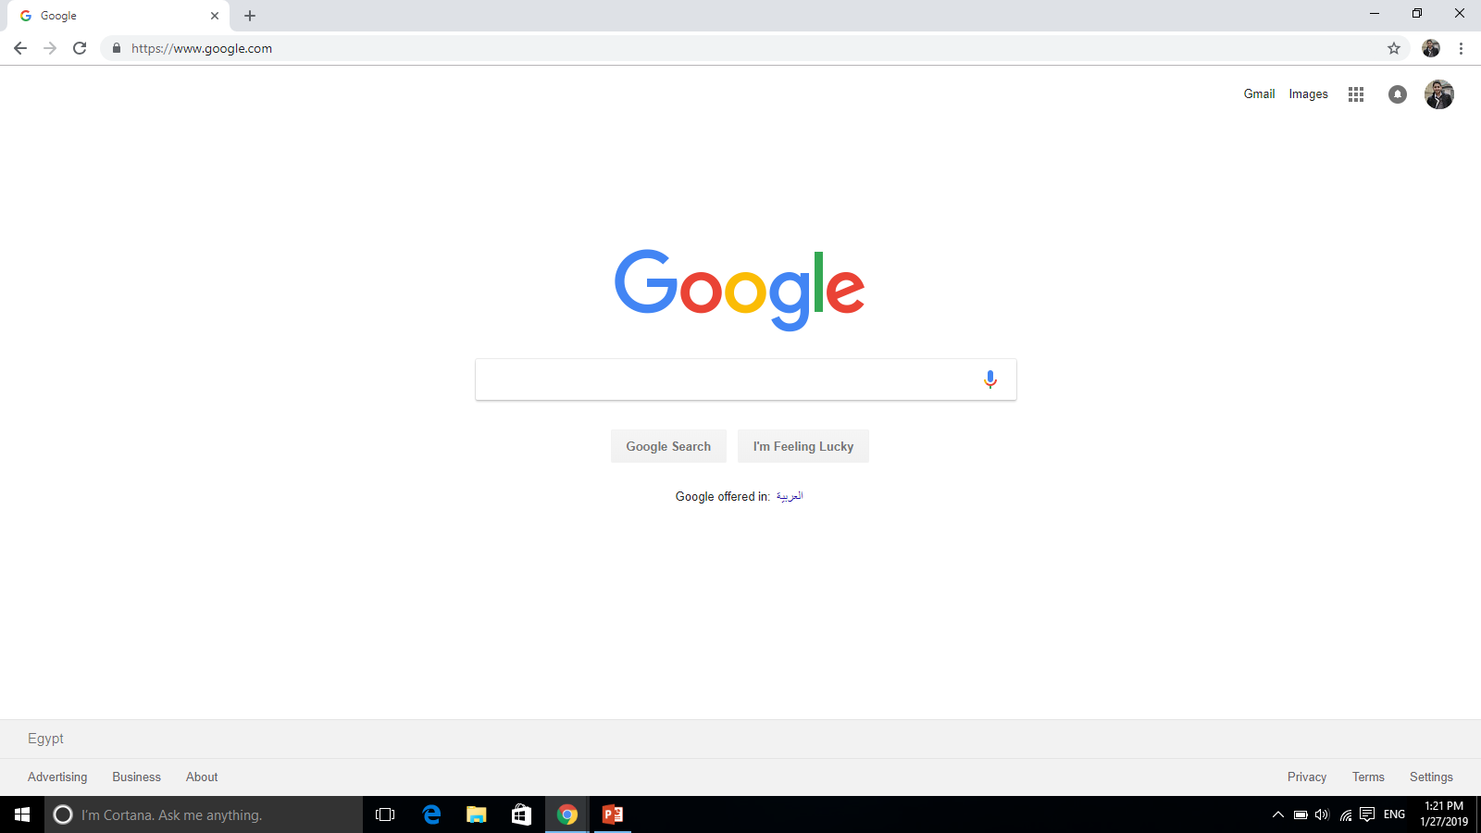

Client Agent
DNS server
(1) DNS look up www.google.com
(2) DNS resolves name to IP address (172.217.171.228)
2.2 HTTP Request Response Cycle
(3) HTTP Request
(8) HTTP Response
(7) HTTP Response
(6) Fetched data
(4) Redirect request to application server
(5) Fetch data
Web Server (nginx / Apache)
Application Server (express)
Database server

Slide 20
2.2 HTTP Guidelines

Slide 21
2.2.1 HTTP General guidelines
HTTP request/response usually consists of request/response header and request/response body according to http method.
headers hold metadata about the request/response.(http method, accepted format)
body usually consists of actual data sent from/to client/server.

Slide 22

2.2.2 URL
Stands for Uniform Resource Locator
URL/URI (uniform Resource Identifier): refers to any resource that needs to be fetched. It may be a physical resource or not. (“/users” , “/users/user1/posts”)

Slide 23
2.2.3 HTTP METHODS
It is a way used by cliet to describe the type of request(action) being made.
client may request to create, delete, update or simply read from a resource.
this corresponds to making POST, DELETE, PUT or GET requests respectively.
There are other HTTP methods like HEAD, OPTIONS …etc.

Slide 24
2.2.4 HTTP STATUS CODE
It is a useful way to provide information to client about the status of a request.
HTTP defines several status codes, each pertaining to a specific scenario.
2xx: imply that the request completed successfully. (200)
3xx: A code in the 3xx series implies redirection. (301)
4xx: A 4xx errors are used when there is an error. (400, 401, 422, 404)
5xx: Lastly, a 5xx response is used when there is an error on the server side. (500)
A Full list of HTTP status code: https://httpstatuses.com/

Slide 25
2.2.4 HTTP HEADERS
They serve to provide additional information for handling requests and responses.
They appear as key value pairs and provide a host of information such as:
The cache policy for the response.
the acceptable response types enforced by the client.
the preferred language of response.
Encoding.
Credentials for authentication and authorization — such as access tokens .

Slide 26
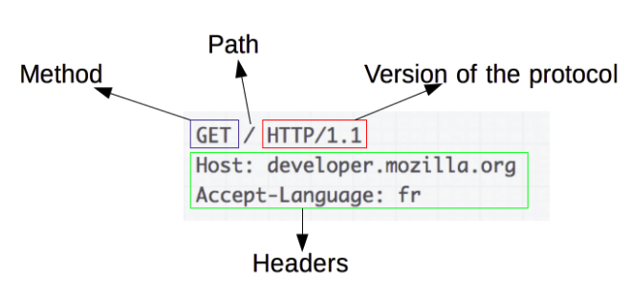
2.2.5 HTTP REQUEST

Slide 27
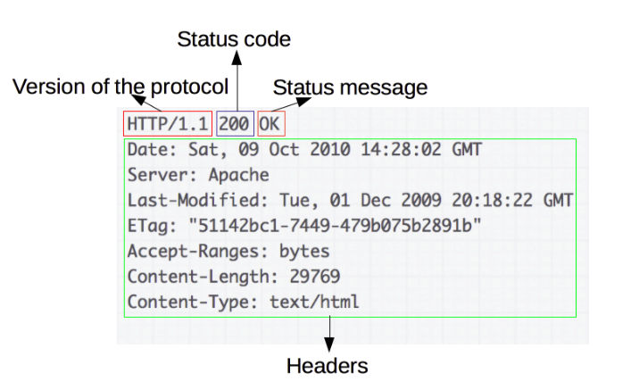
2.2.5 HTTP RESPONSE

Slide 28
Wep app evolution
Static content sites
Dynamic content sites
User oriented Apps

Slide 29
What happens when you type a website in your browser
Notes:
https://webwhiteboard.com/

Slide 30
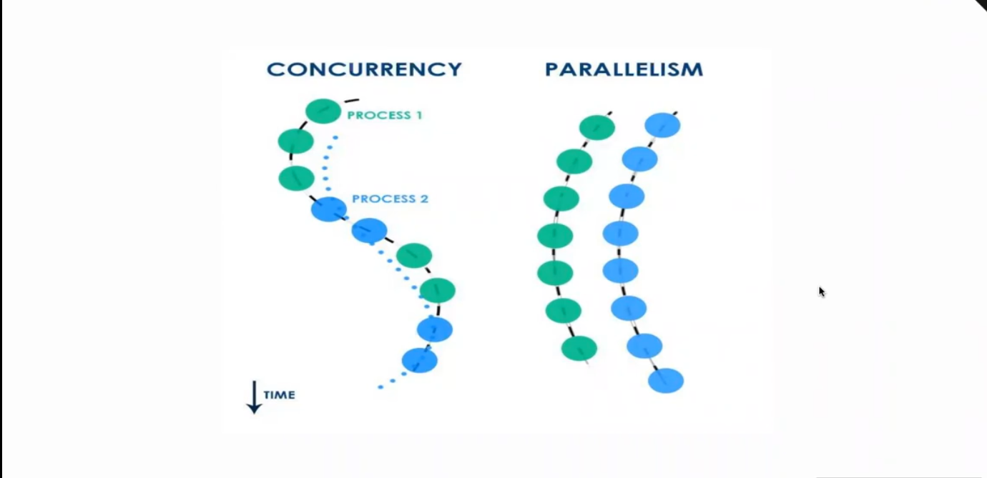
Notes:
https://webwhiteboard.com/

Slide 31
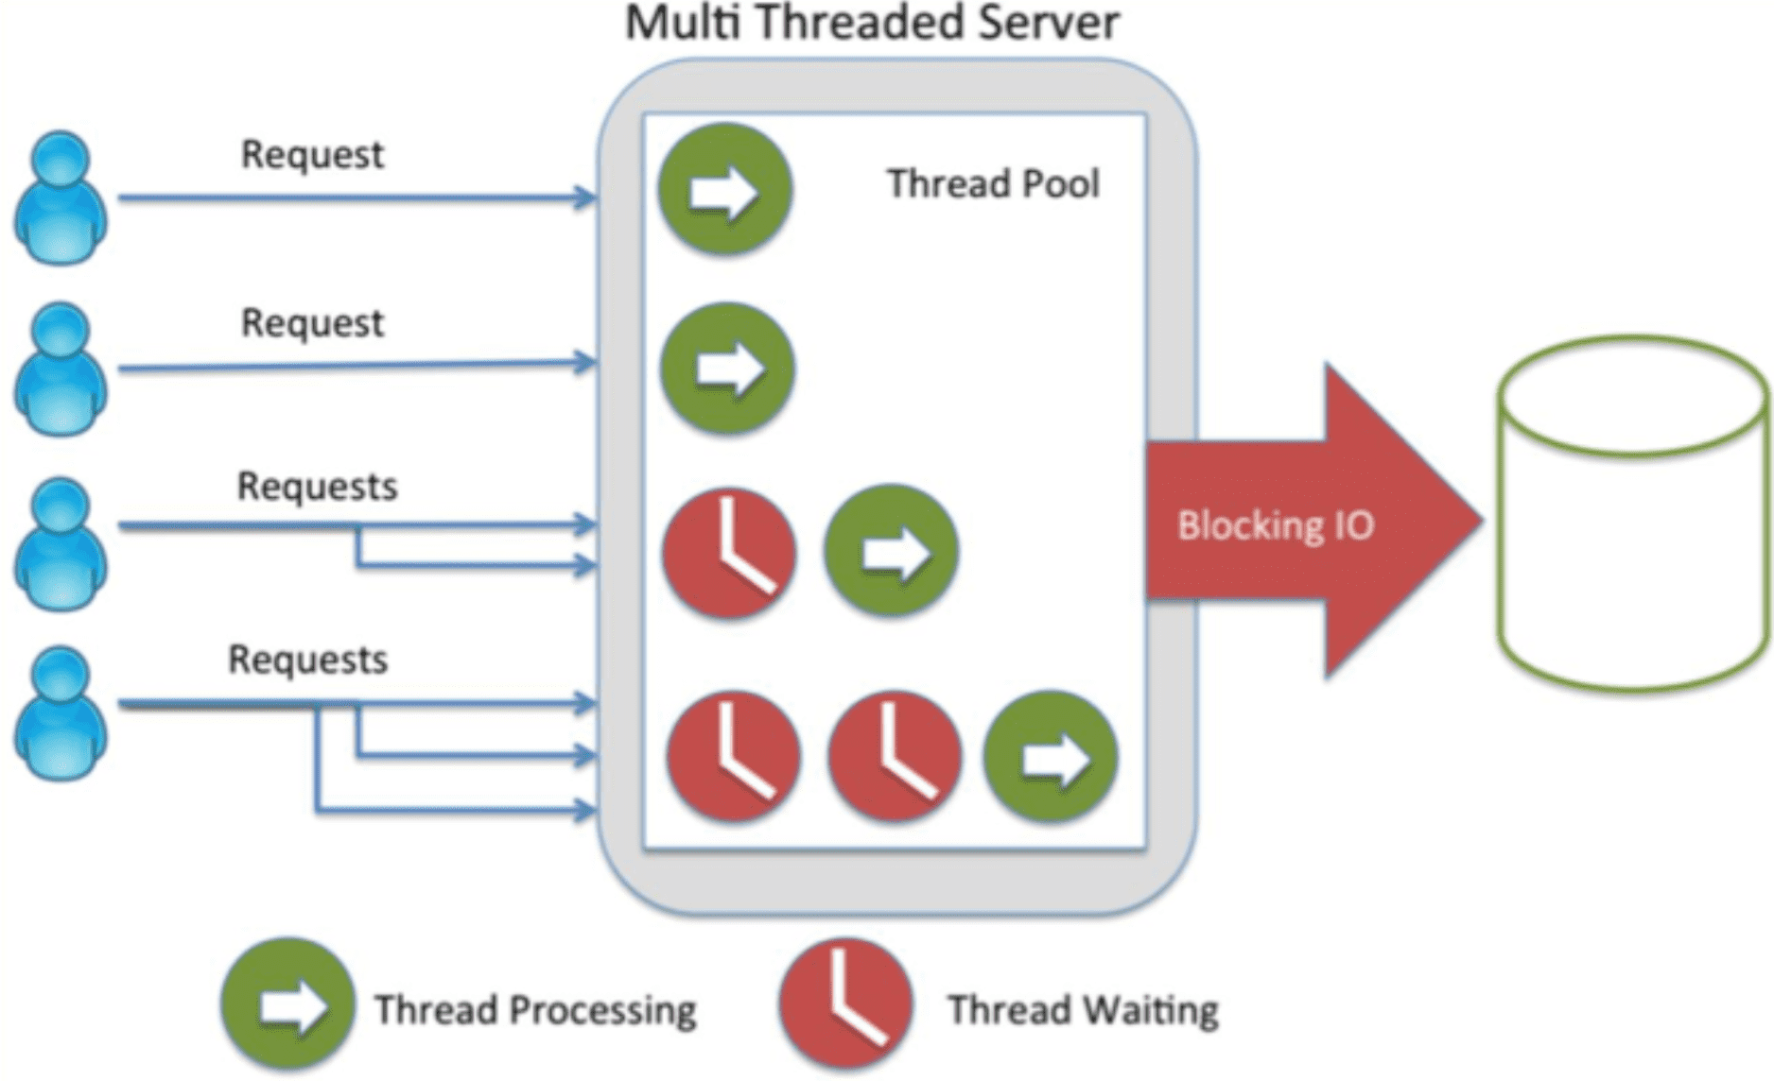
Notes:
https://webwhiteboard.com/

Slide 32
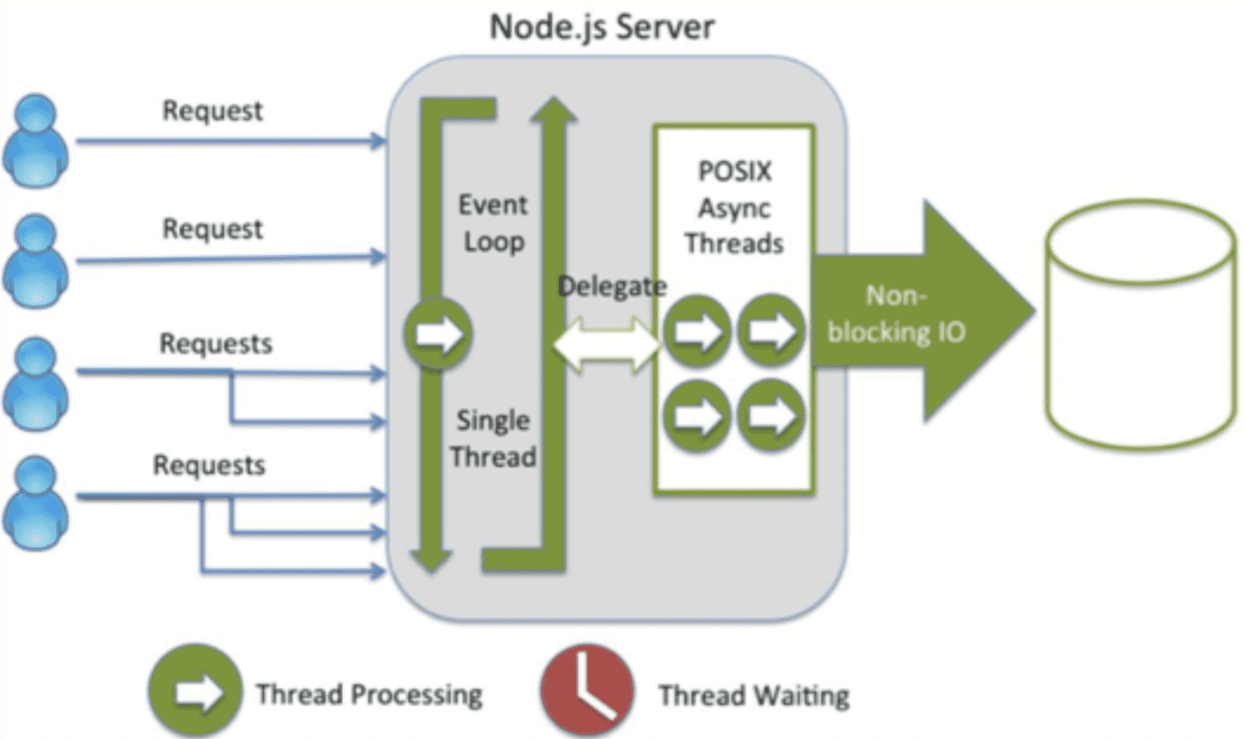
Notes:
https://www.youtube.com/watch?v=8aGhZQkoFbQ

Slide 33
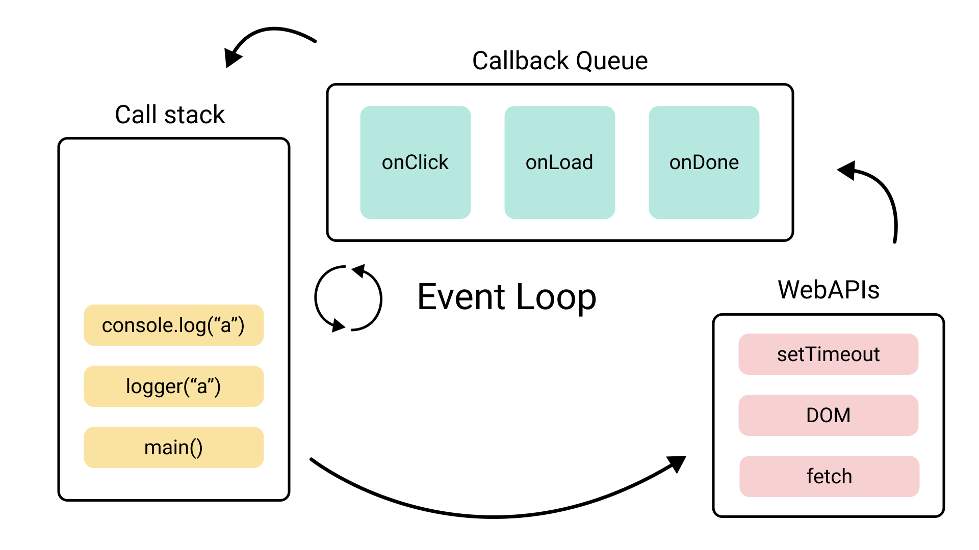
Notes:
https://webwhiteboard.com/

Slide 34
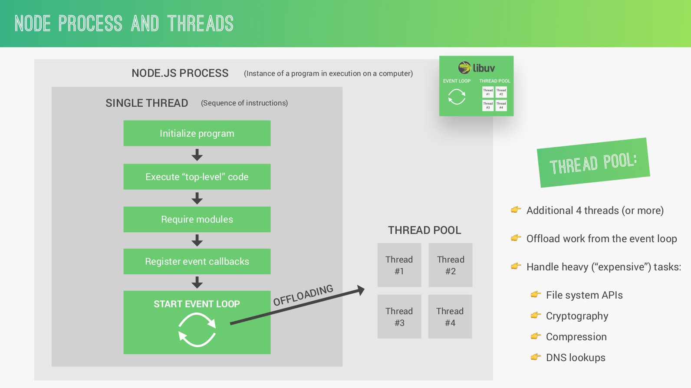

Slide 35
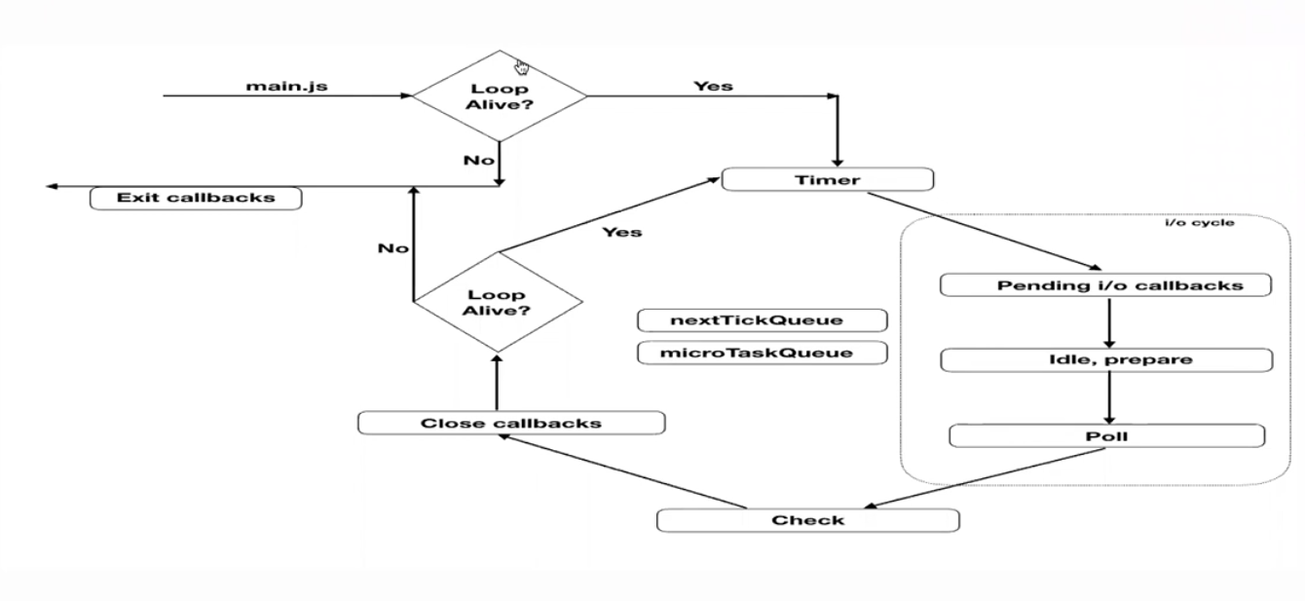

Slide 36
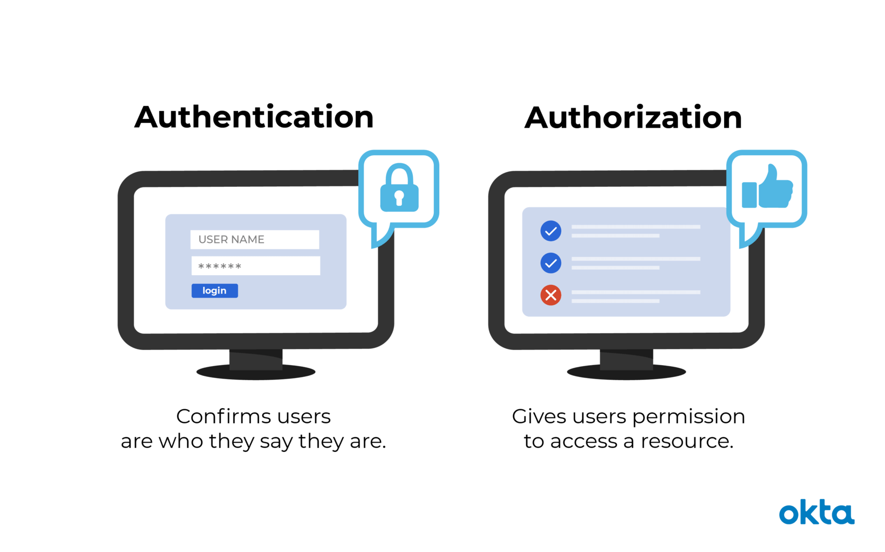

Slide 37
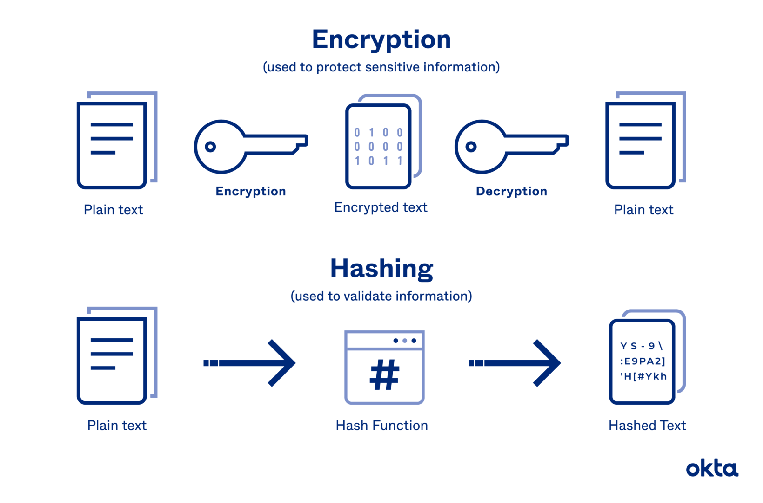
Hashing vs Encryption

Slide 38
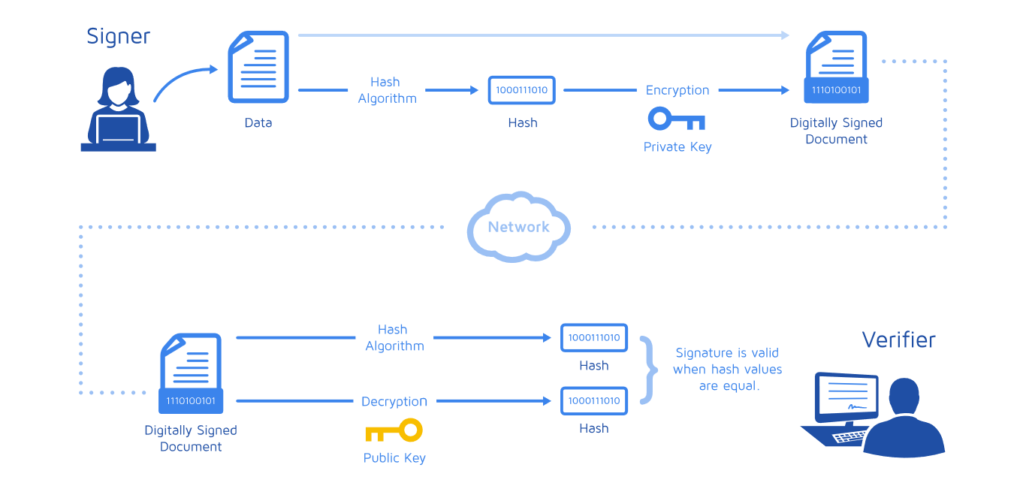

Slide 39
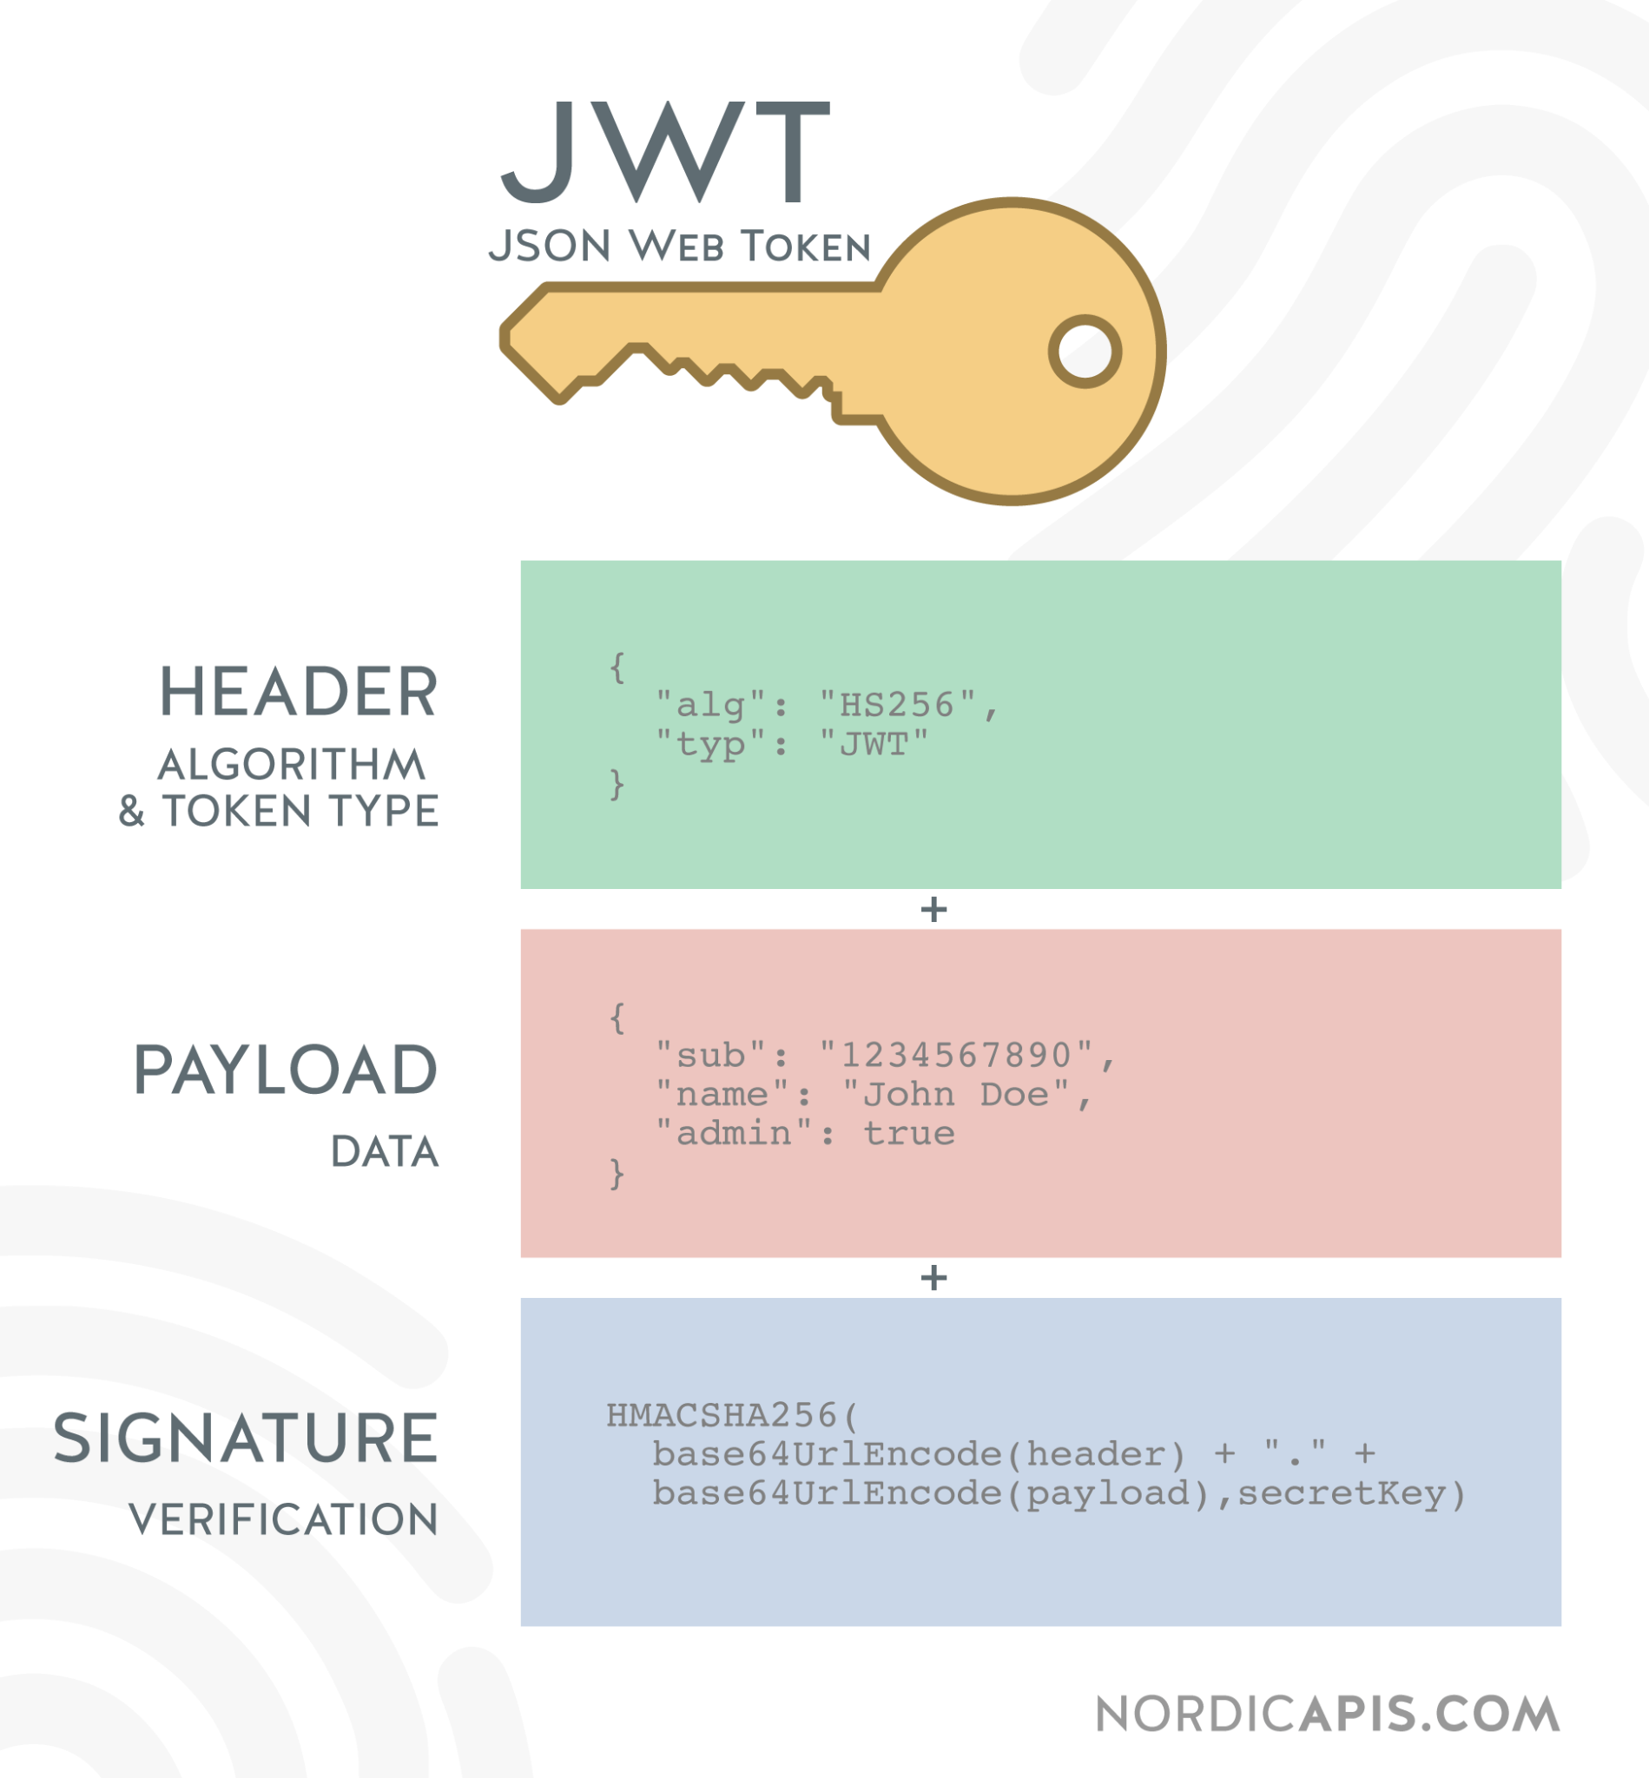

Slide 40
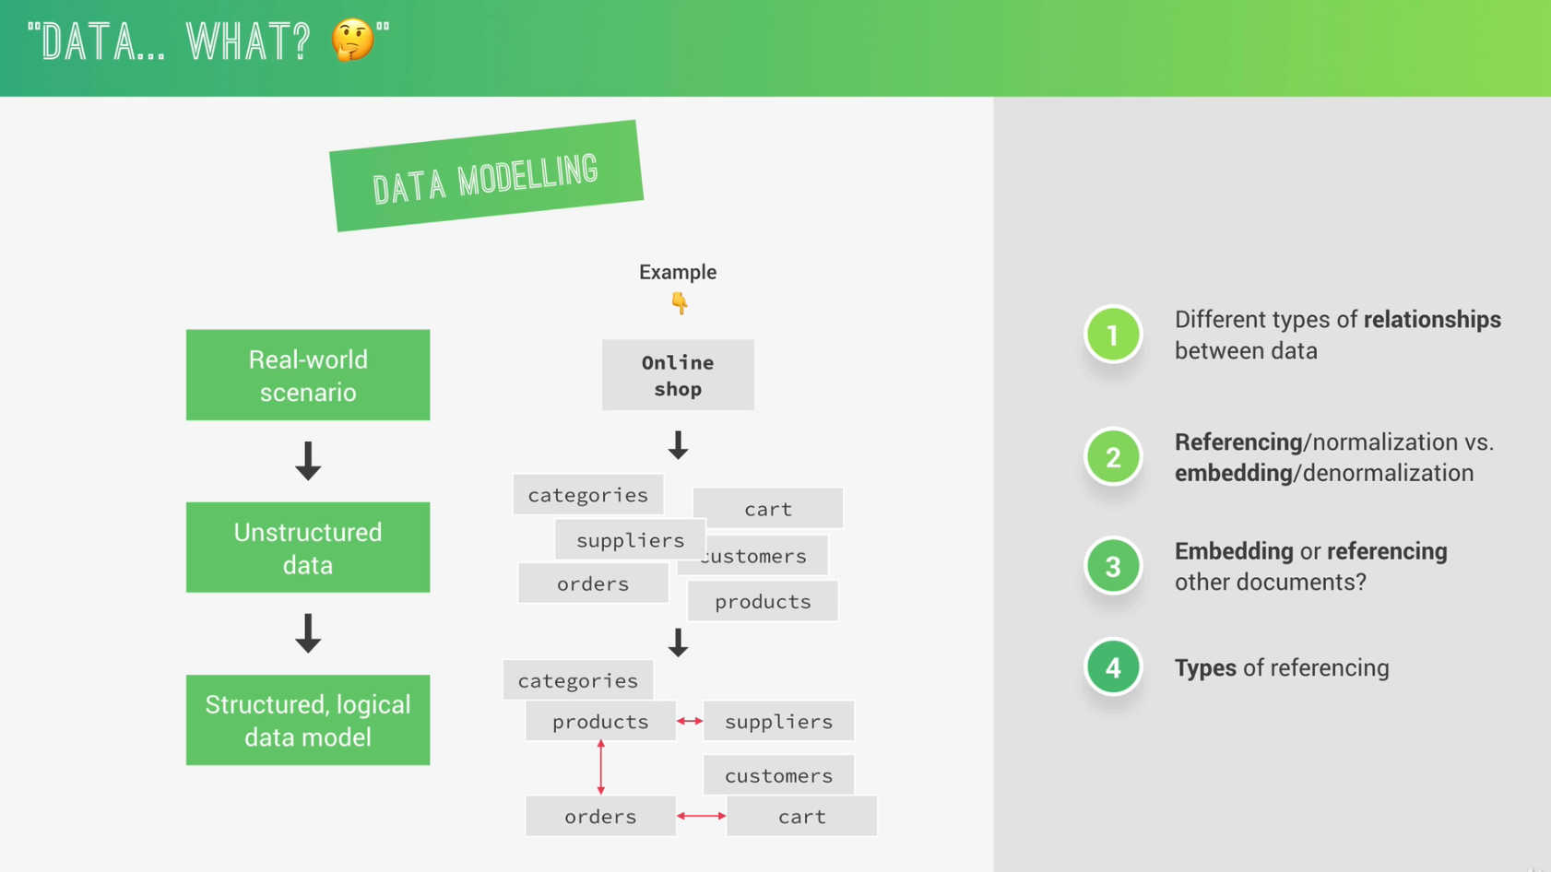

Slide 41
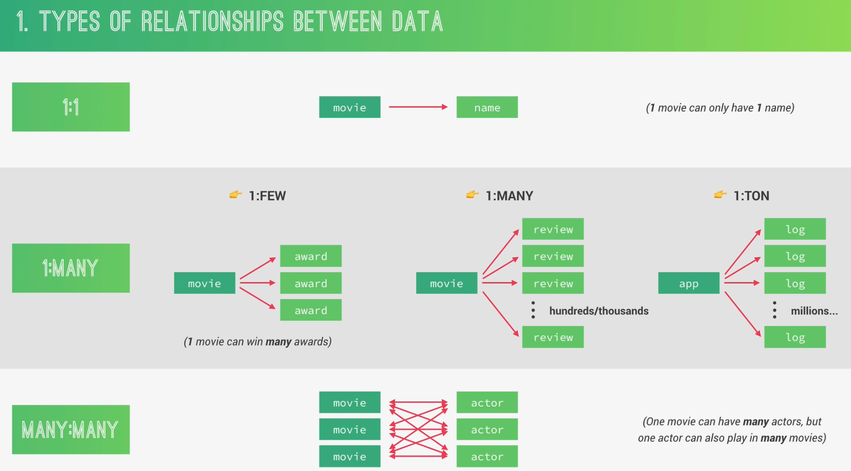

Slide 42
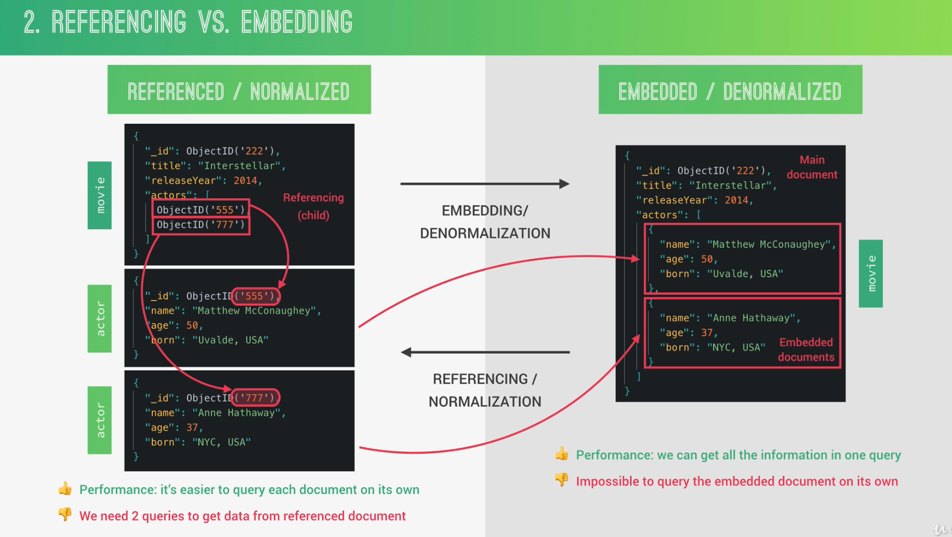

Slide 43
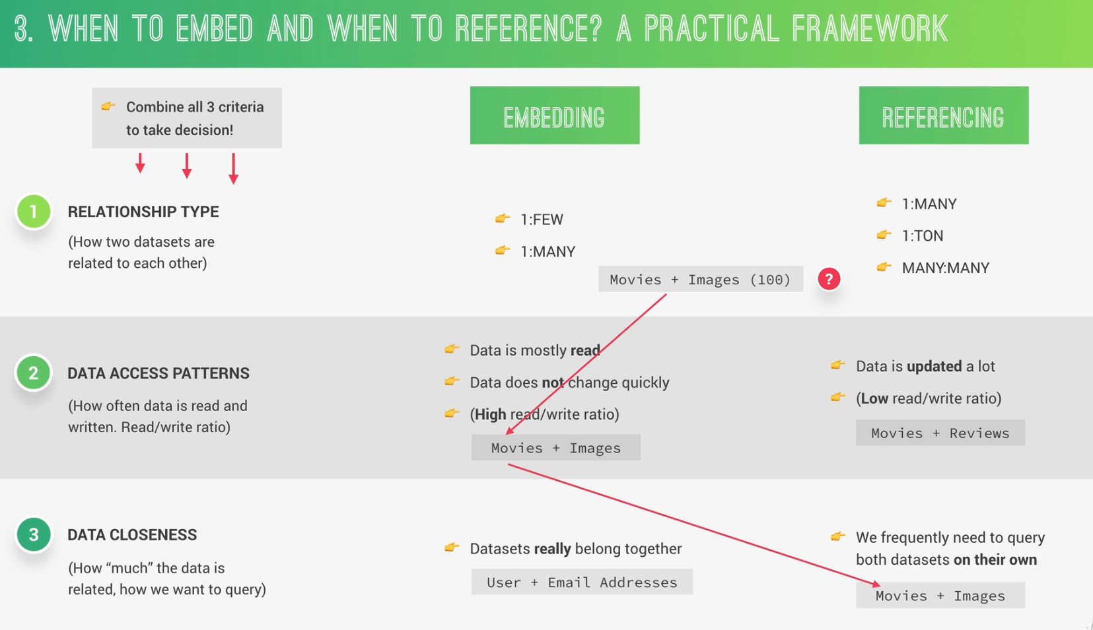

Slide 44
